Slide 1
Metadata content for the NHS Data Dictionary for Care using ISO 13119
Rahil Qamar Siddiqui
Clinical Information Architect
Health and Social Care Information Centre
NHS, UK

Slide 2
Outline
Data Dictionary for Care (DD4C) – What is it?
Metadata requirements
ISO13119 – Health informatics: Clinical knowledge resources – Metadata
Applying ISO13119 to DD4C
Pilot user interface for cataloguing data
What is in it for CIMI – coverage of openEHR, ISO13606 and DCM metadata

Slide 3
Data Dictionary for Care – What is it?
The requirement for a data dictionary to underpin care concepts has been identified within Information Standards to meet initiatives outlined in The Power of Information: Putting all of us in control of the health and care information we need published in May 2012 as part of the Information Strategy.
The Data Dictionary for Care service plans to catalogue existing published content, harmonise wherever possible (and sensible), and offer a standard representation to support implementation of interoperable patient records.
The scope also includes providing a library of definitions to support direct delivery of care and support the representation of care content through application of standards, including SNOMED CT

Slide 4
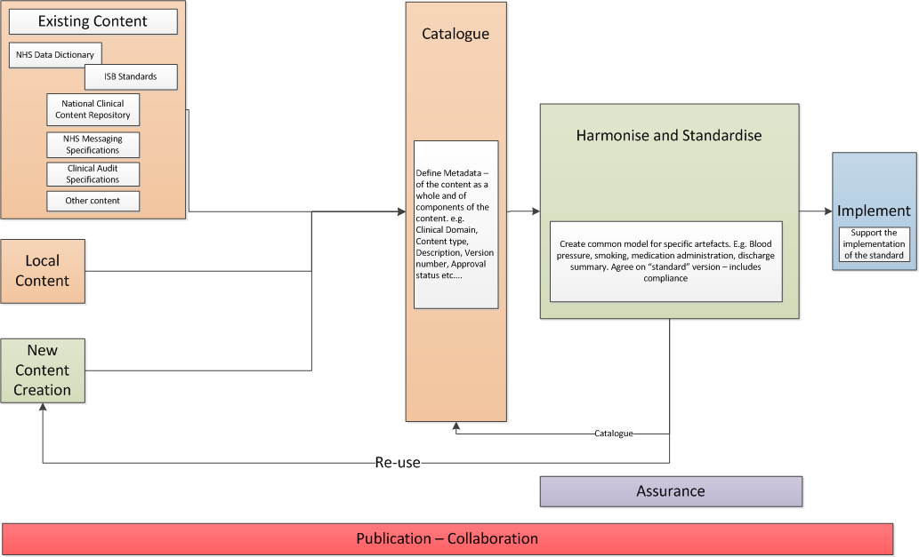
Components of DD4C
Notes:
Inputs to the Data Dictionary for Care
Content for the Data Dictionary for Care will be sourced from one of 3 areas
Existing Content – this will include but not be restricted to ; the NHS Data Dictionary, ISB Standards, Content from the National Clinical Content Repository, NHS Message Specifications, Clinical Audit Specifications.
Local Content – Potentially local NHS organisations could catalogue their own content on the Data Dictionary for Care.
New data Definitions when created will be populated into the Data Dictionary for Care.
Catalogue
The catalogue component of the Data Dictionary for Care will create an organised, searchable repository of care data definitions. This will be made freely available.
Harmonise and Standardise
Deriving source requirements information from the catalogue, common models for specific artefacts will be produced. E.g. common/harmonised models for smoking, blood pressure, discharge summary.

Slide 5
Metadata requirements
The solution must support the recording of metadata against artefacts in DD4C.
The solution must support a controlled meta data vocabulary that can be extended/modified to suit requirements.
The solution must provide a means to identify mandatory elements of metadata. Records with blank mandatory fields can only be saved as work in progress.

Slide 6
Metadata requirements
Audit - Date of creation/modification, author, etc. (Must)
Versioning - Version numbers and dates. (Must). This is the version of the specific artefact as stated by the artefact author.
Currency - Whether the artefact is actively being maintained. E.g. Up-to-date/ Not up-to-date/ deprecated, superseded (and by what)
Release status - A formal status of the artefact, as defined by the author. E.g. Draft, Informative, review stage, DSTU, normative, etc
Assurance - The level and type of assurance that the artefact has achieved. E.g. approved by the Royal College of Surgeons
Information type - Categorise the artefact into high level type. Using adapted 13606 e.g. FOLDER/SUB-FOLDERS, COMPOSITION, SECTION (with more user friendly terms).
.........

Slide 7
Characteristics of good metadata
The Framework of Guidance for Building Good Digital Collections, available on the NISO website, articulates six principles applying to good metadata:
• Good metadata should be appropriate to the materials in the collection, users of the collection, and intended, current and likely use of the digital object.
• Good metadata supports interoperability.
• Good metadata uses standard controlled vocabularies to reflect the what, where, when and who of the content.
• Good metadata includes a clear statement on the conditions and terms of use for the digital object.
• Good metadata records are objects themselves and therefore should have the qualities of archivability, persistence, unique identification, etc.
Good metadata should be authoritative and verifiable.
• Good metadata supports the long-term management of objects in collections.

Slide 8
Demo
DD4C Metadata Model (DSTU)

Slide 9
Demo
DD4C User Interface with metadata

Slide 10
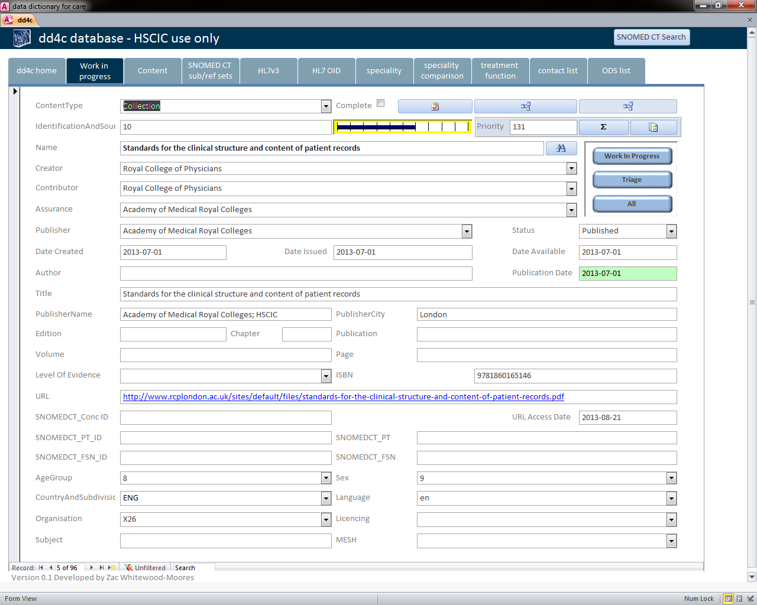
DD4C User Interface with metadata

Slide 11
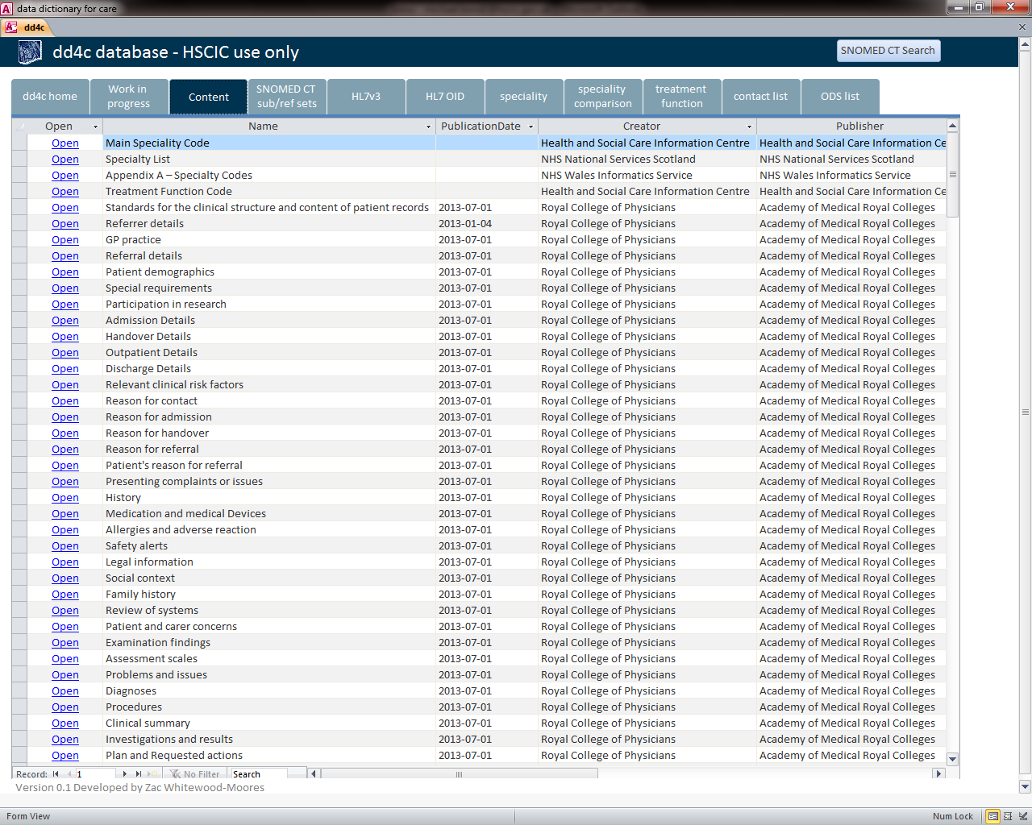

Slide 12
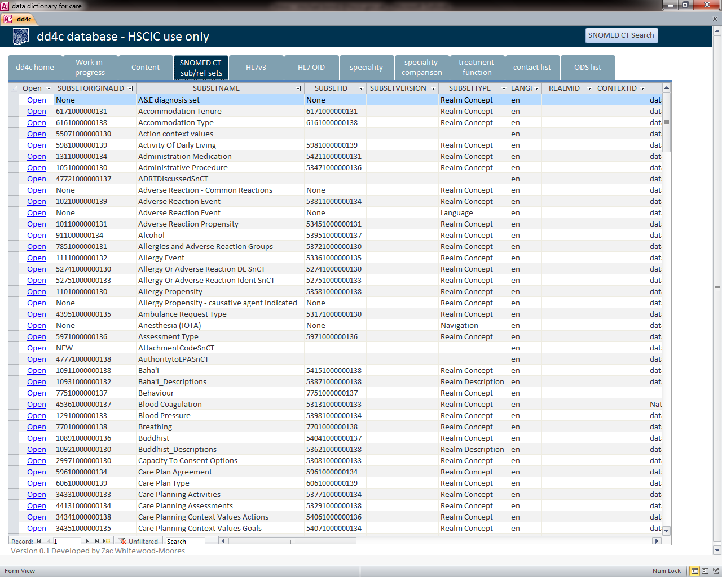

Slide 13
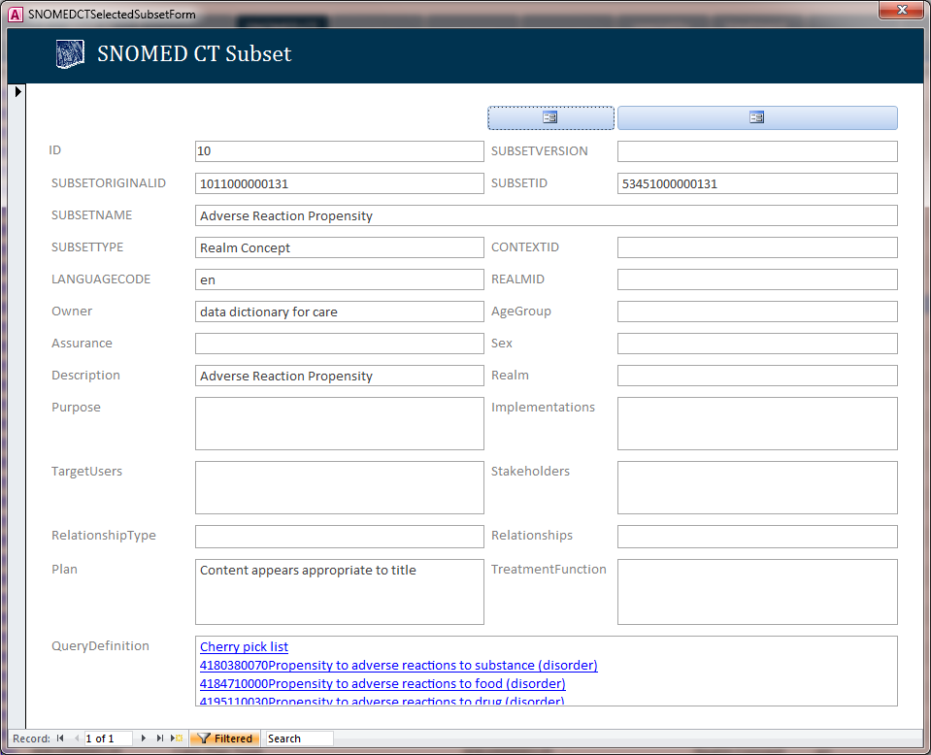

Slide 14
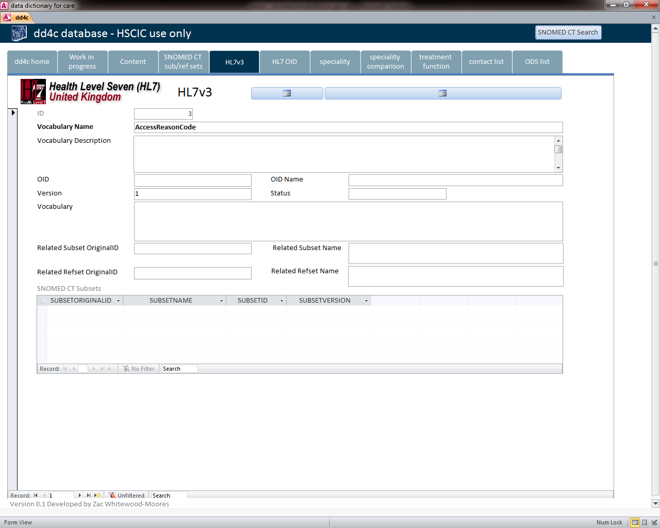

Slide 15
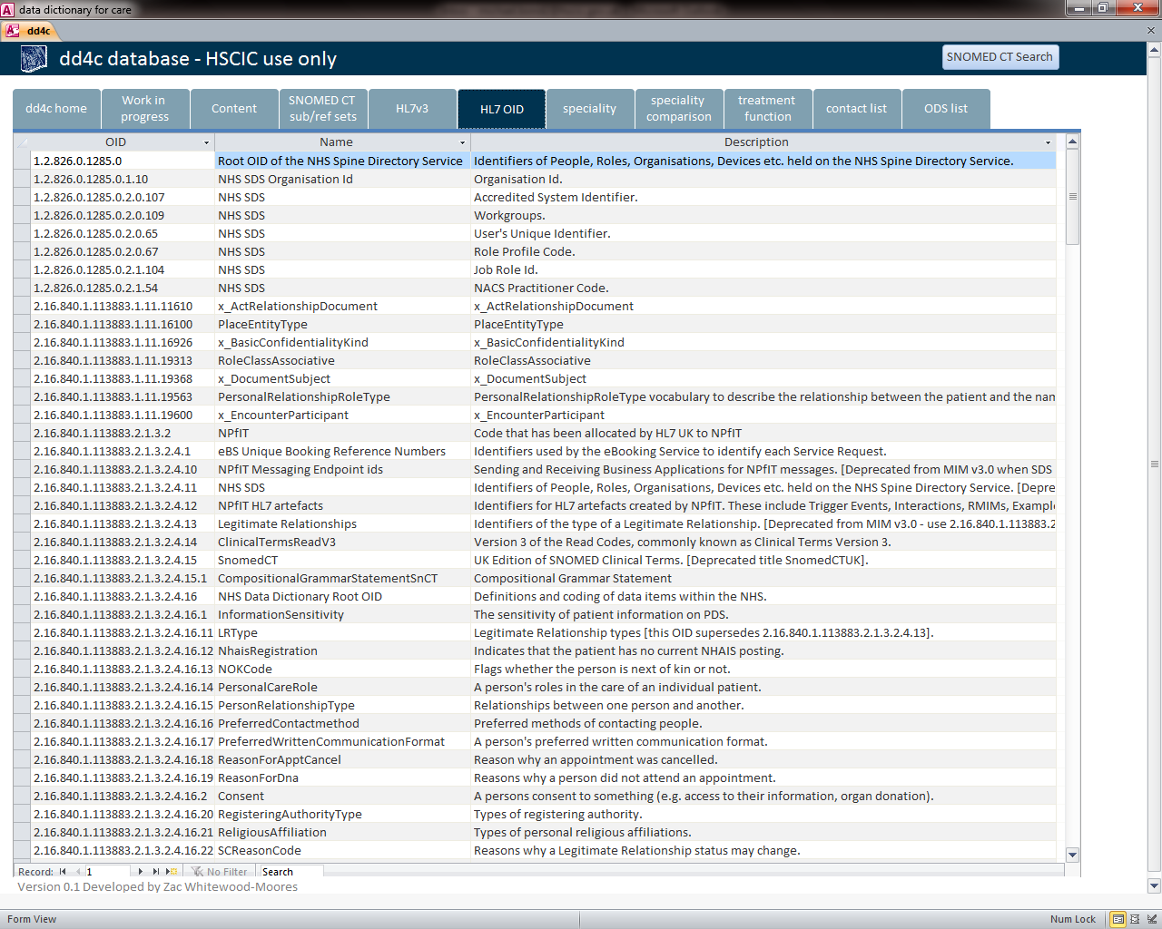

Slide 16
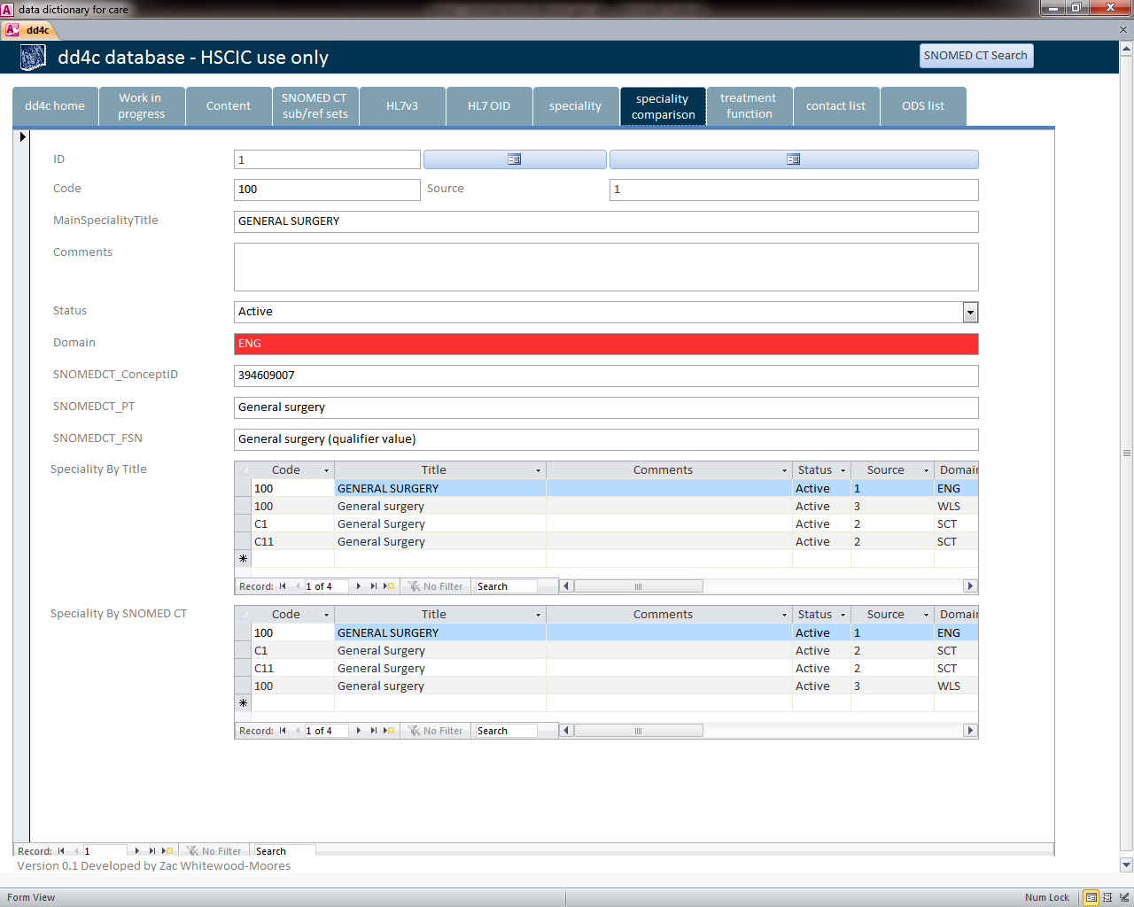

Slide 17
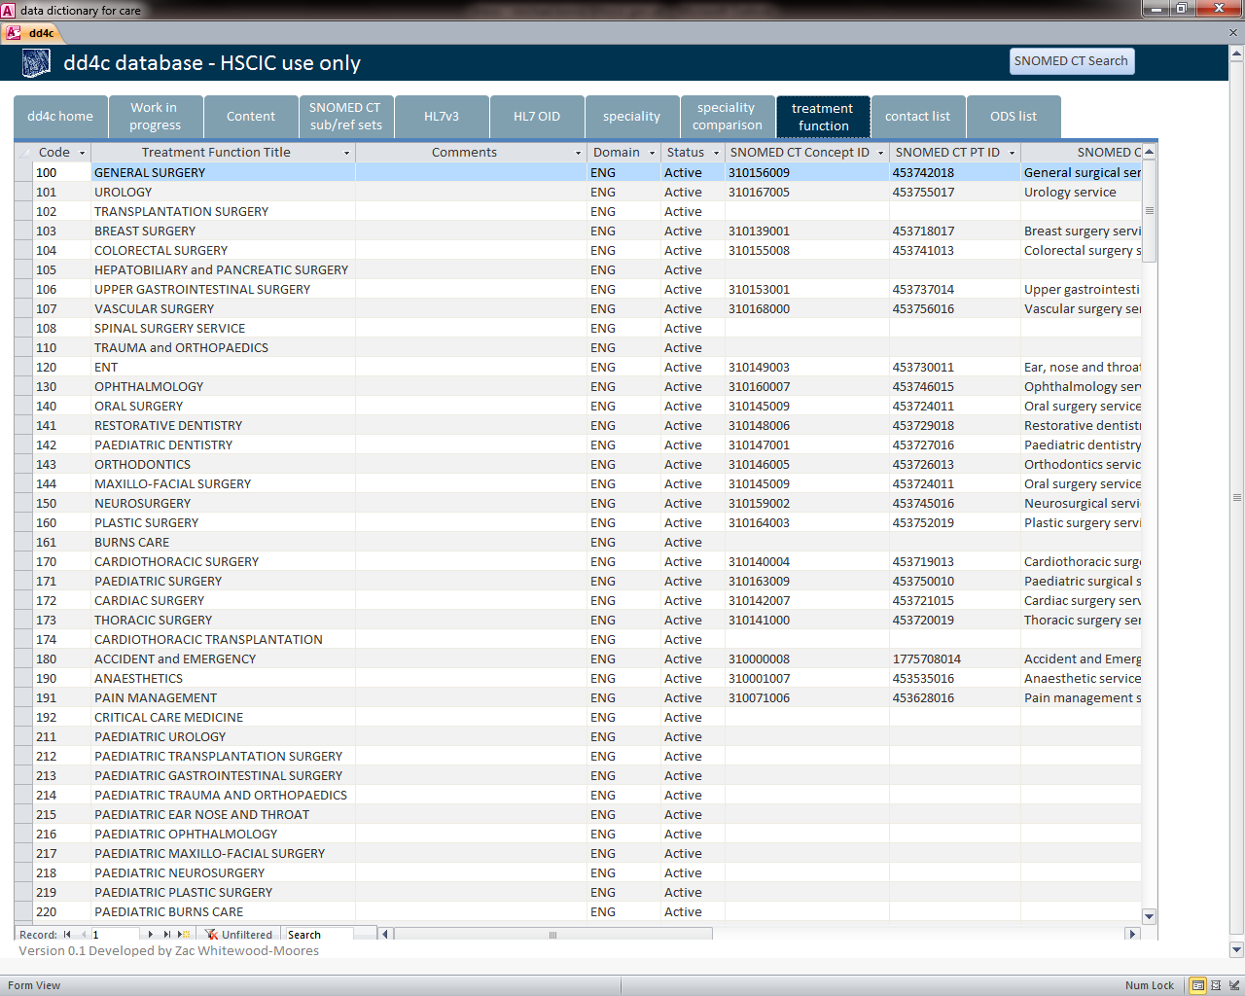

Slide 18
What is in it for CIMI?
Coverage of openEHR and DCM metadata. Demo

Slide 19
Thank you

